Slide 1
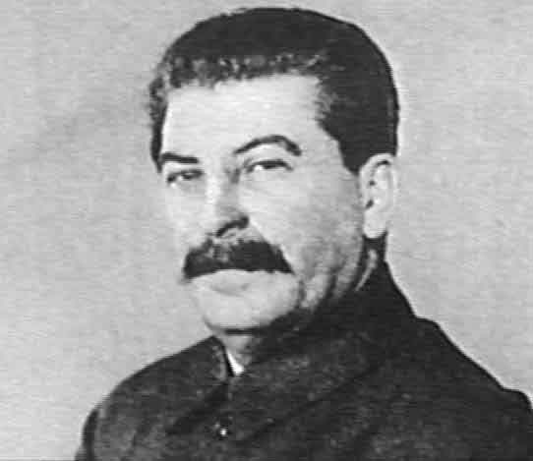
STALIN’S CONTROL OF THE SOVIET PEOPLE

Slide 2
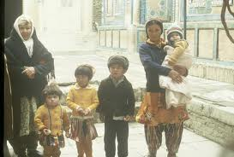
WEAKENED THE FAMILY
In the late 1920’s and early 1930’s
While the family remained important in the USSR, Stalin wanted to weaken it so that people would be loyal 1st and foremost to Stalin & the CPSU.
Abortion laws were passed, making abortion freely and easily obtainable. This aimed at reducing the numbers of unwanted children but also went against the traditional sacred nature of the Russian family.
Creches were built & women were expected to return to work soon after the birth of a child. This aimed at weakening the bonds between mother & child.
Children were encouraged to “tell on “ their parents or siblings if they did or said anything against Stalin and the USSR.
Divorce was made easy to obtain

Slide 3
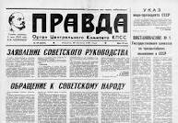
CONTROLLED THE MEDIA
Stalin & the CPSU made sure it controlled all the important media in the USSR – newspapers, books, magazines, films, radio, posters. All were run by the State.
The main newspaper was called PRAVDA (Truth) and was run by the CPSU
Access to media from outside the USSR was tightly controlled. Foreign radio stations were “jammed”.
Censorship was tightened so that the people were only receiving the “Party Line”.
Images of Stalin were doctored to portray him as “bigger than life” and as a father to his people.

Slide 4
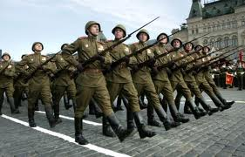
CONTROLLED THE MILITARY
The Red Army was set up in 1920. From the start ,the CPSU realised how important it was to keep control over the military.
Every unit in the Armed Forces had a Political Commissar ( representing the CPSU). The Commisar could overrule the military commander .
An effort was made to educate and indoctrinate the soldiers in CPSU beliefs.
Stalin would have any senior officers removed who questioned his authority or he felt posed a threat .

Slide 5
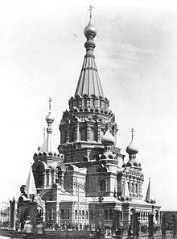
WEAKENED THE CHURCH
LENIN SAID: “RELIGION IS THE OPIUM OF THE PEOPLE”
The vast majority of Soviet people were deeply religious and intensely loyal to the Russian Orthodox Church. Stalin wanted to replace a belief in God and the Orthodox Church with worship of Stalin and the CPSU
Although freedom of religion was officially allowed, many steps were taken after the late 1920’s to crush religion in the USSR. Eg
Over 50,000 Churches closed
Church land confiscated
Many priests arrested, some executed.
People were discouraged from attending Church. Eg lost place on housing list

Slide 6
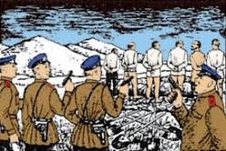
USED THE SECRET POLICE
The Secret Police had been a feature of Life in Russia since the 19th C. Under the Communists they were known successively as the Cheka, OGPU, NKVD, & KGB.
The main roles of the Secret Police was to gain information on and rid the USSR of “enemies of the people.” These enemies could be internal or external.
The methods used included setting up and running labour camps (gulags) throughout the USSR, paying informants, “buggimg”,torture.
The secret police was greatly feared by most Soviet citizens.

Slide 7
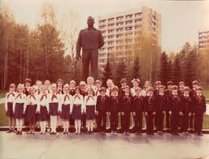
CONTROL OF EDUCATION
By controlling education, from pre-school creches through to universities, Stalin and the CPSU were able to control what people grew up thinking & believing
All education was free and compulsory. This resulted in the USSR having one of the world’s highest rates of literacy.
The curriculum was tightly controlled to ensure loyalty to Stalin and the CPSU
Teachers had to follow the set curriculum and show support for Stalin and the CPSU. Common texts were produced for all schools to use.

Slide 8
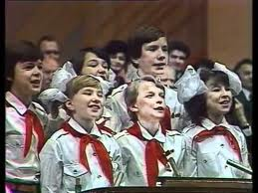
ORGANISED THE KOMSOMOL
Communist youth organisation – a bit like a political boy scout/girl guide organisation.
For young people 14 – 28. Not compulsory but young people were encouraged to join.
The main aim was to teach communist values to the young.
Smoking, drinking , religion, individuality was seen as hooliganism. Tended to show great loyalty to Stalin.
Summer camps, more likely to get a place at University.

